Slide 1
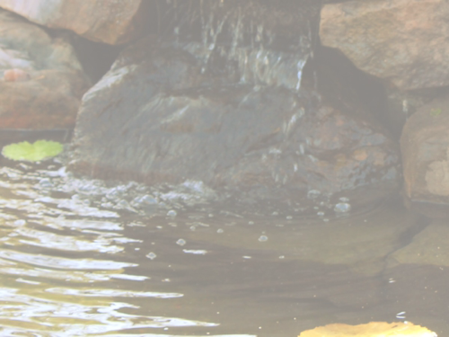
I've Got Peace Like a River
1. I've got peace like a river,
I've got peace like a river,
I've got peace like a river in my soul.
I've got peace like a river,
I've got peace like a river,
I've got peace like a river in my soul.

Slide 2
I've Got Peace Like a River
2. I've got love like a river,
I've got love like a river,
I've got love like a river in my soul.
I've got love like a river,
I've got love like a river,
I've got love like a river in my soul.

Slide 3
I've Got Peace Like a River
3. I've got joy like a river,
I've got joy like a river,
I've got joy like a river in my soul.
I've got joy like a river,
I've got joy like a river,
I've got joy like a river in my soul.

